Slide 1




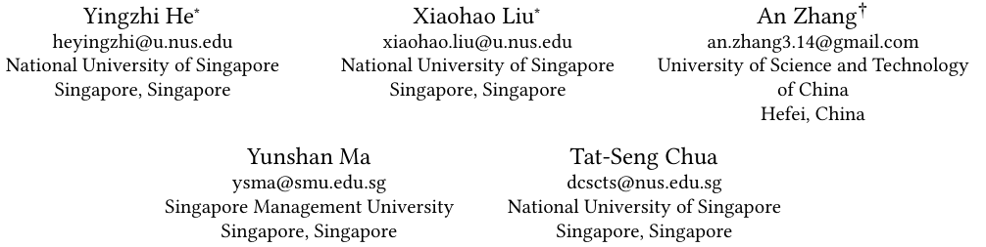





ATAI
Advanced Technique of Artificial Intelligence
ATAI
ChongqingUniversity _{AdvancedTechniqueof}
of Technology Artificial Intelligence
Chongqing University of Technology
Chongqing University ^{ATAI}
_{of Technology} Advanced Techniqueof
Artificial Intelligence
Chongqing University of Technology
Chongqing University of Technology
LLM2Rec: Large Language Models Are Powerful Embedding
Models for Sequential Recommendation
code:https://github.com/HappyPointer/LLM2Rec
—— KDD’25
Reported by Jinfei Chen
1

Slide 2
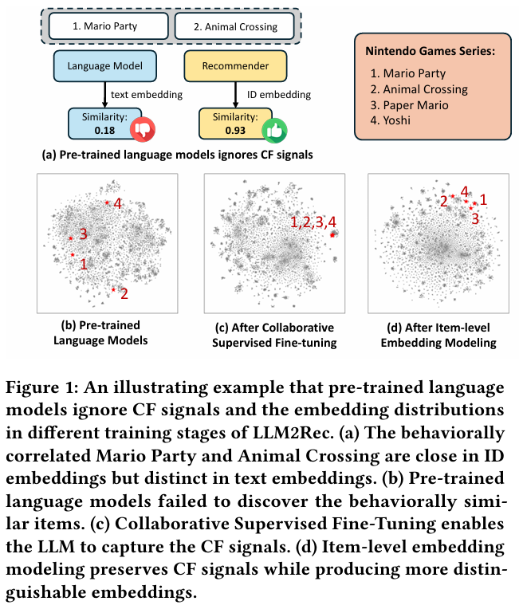
ATAI
Advanced Technique of
Artificial Intelligence
ATAI
ChongqingUniversity _{AdvancedTechniqueof}
of Technology Artificial Intelligence
Chongqing University of Technology
Motivation
Sequential recommendation aims to predict users’ future interac tions by modeling collaborative filtering (CF) signals from historical behaviors of similar users or items.
Traditional sequential recommenders predominantly rely on ID-based embeddings, which capture CF signals through high-order co-occurrence patterns.
However, these embeddings depend solely on past interactions, lacking transferable knowledge to generalize to unseen domains. Recent advances in large language models (LLMs) have motivated text-based recommendation approaches that derive item representations from textual descriptions.
While these methods enhance generalization, they fail to encode CF signals—i.e., latent item correlations and pref erence patterns—crucial for effective recommendation

Slide 3
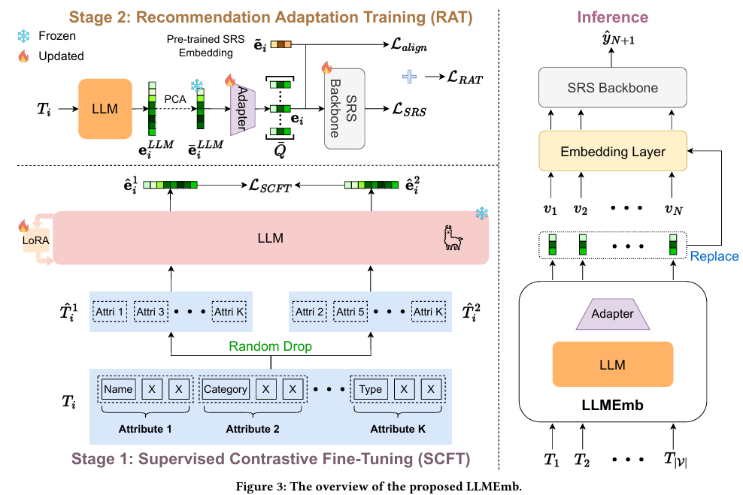
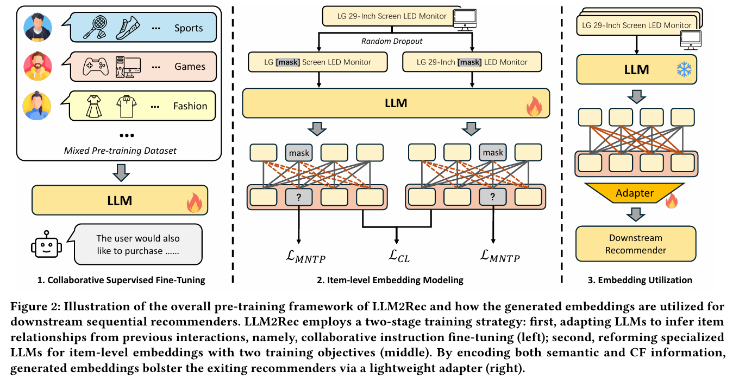
ATAI
Advanced Technique of
Artificial Intelligence
ATAI
ChongqingUniversity _{AdvancedTechniqueof}
of Technology Artificial Intelligence
Chongqing University of Technology
Overview

Slide 4
ATAI
Advanced Technique of
Artificial Intelligence
ATAI
ChongqingUniversity _{AdvancedTechniqueof}
of Technology Artificial Intelligence
Chongqing University of Technology
25_AAAI_Large Language Model Empowered Embedding Generator for Sequential Recommendation

Slide 5
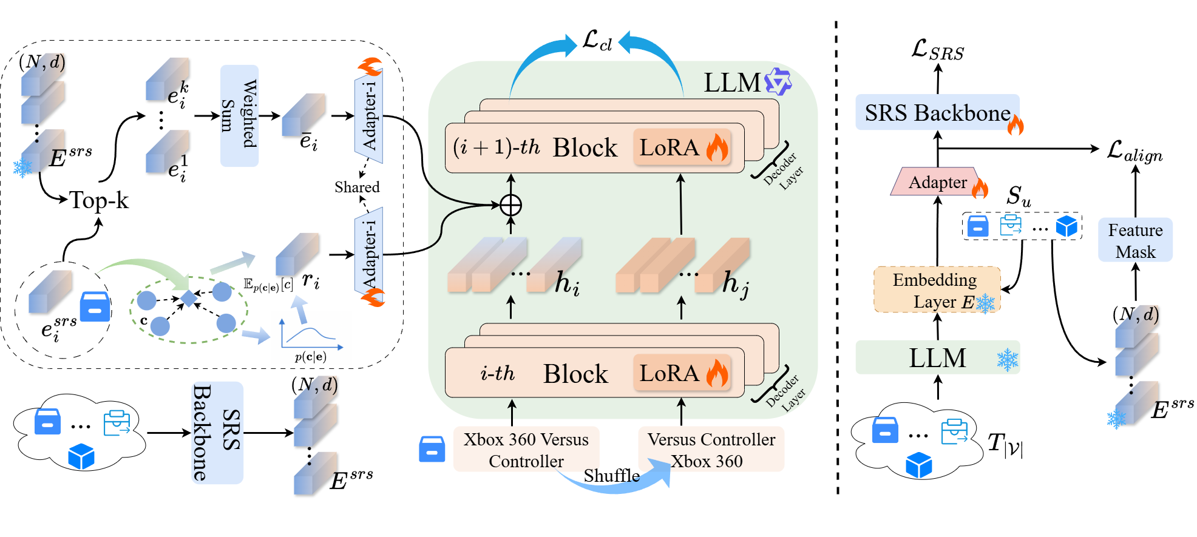
ATAI
Advanced Technique of
Artificial Intelligence
ATAI
ChongqingUniversity _{AdvancedTechniqueof}
of Technology Artificial Intelligence
Chongqing University of Technology
Ours

Slide 6
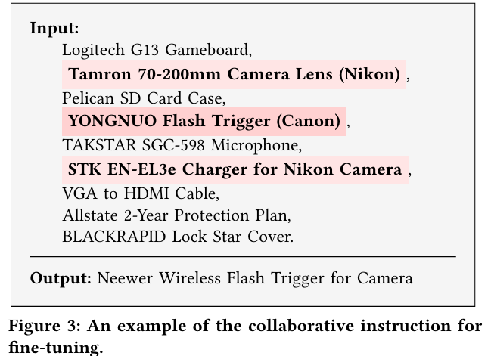
ATAI
Advanced Technique of
Artificial Intelligence
ATAI
ChongqingUniversity _{AdvancedTechniqueof}
of Technology Artificial Intelligence
Chongqing University of Technology
Method

Slide 7



ATAI
Advanced Technique of
Artificial Intelligence
ATAI
ChongqingUniversity _{AdvancedTechniqueof}
of Technology Artificial Intelligence
Chongqing University of Technology
Method

Slide 8
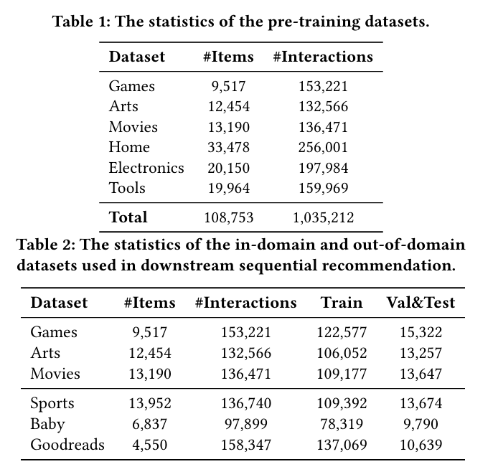
ATAI
Advanced Technique of
Artificial Intelligence
ATAI
ChongqingUniversity _{AdvancedTechniqueof}
of Technology Artificial Intelligence
Chongqing University of Technology
Experiments

Slide 9
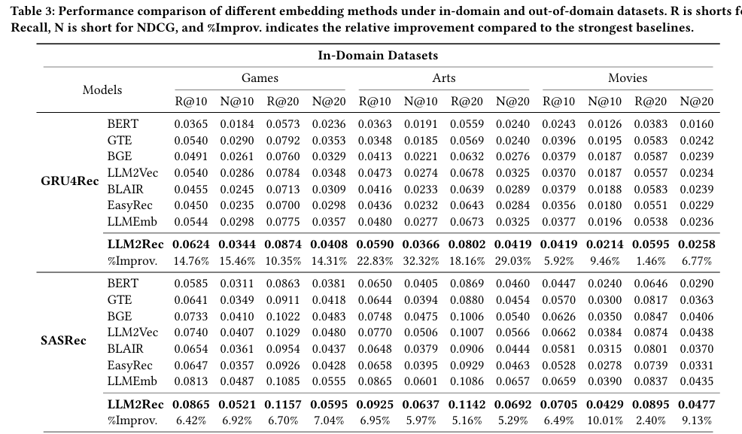
ATAI
Advanced Technique of
Artificial Intelligence
ATAI
ChongqingUniversity _{AdvancedTechniqueof}
of Technology Artificial Intelligence
Chongqing University of Technology
Experiments

Slide 10
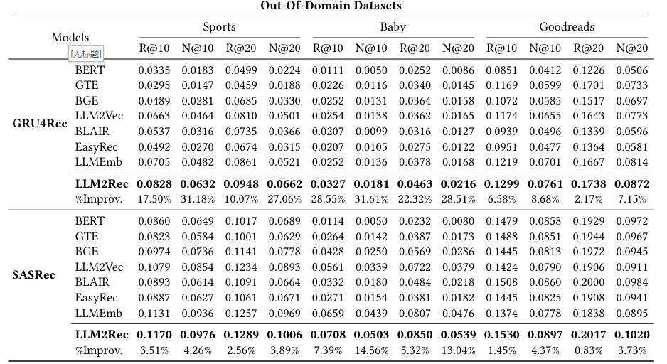
ATAI
Advanced Technique of
Artificial Intelligence
ATAI
ChongqingUniversity _{AdvancedTechniqueof}
of Technology Artificial Intelligence
Chongqing University of Technology
Experiments

Slide 11
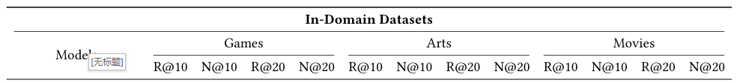
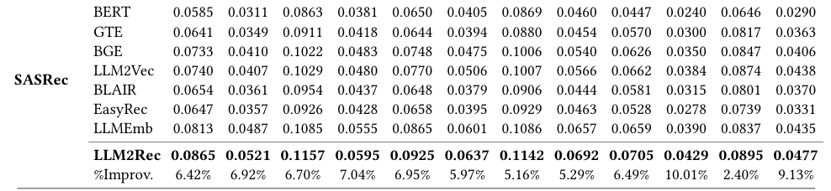
Ours
0.0948 | 0.0653 | 0.1183 | 0.0712 | 0.0926 | 0.0701 | 0.1110 | 0.0747 | 0.0772 | 0.0517 | 0.0905 | 0.0551

Slide 12
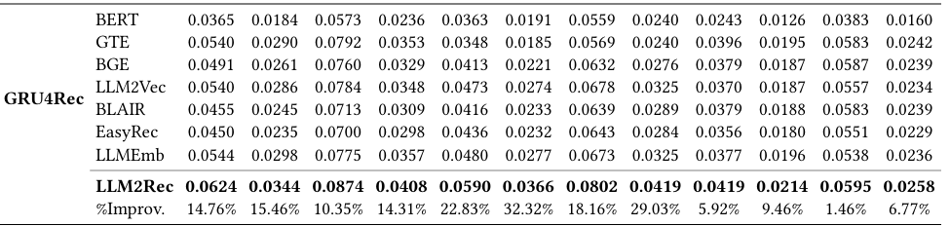
Ours
0.0712 | 0.0447 | 0.0957 | 0.0509 | 0.0637 | 0.0452 | 0.0819 | 0.0498 | 0.0435 | 0.0256 | 0.0599 | 0.0297

Slide 13
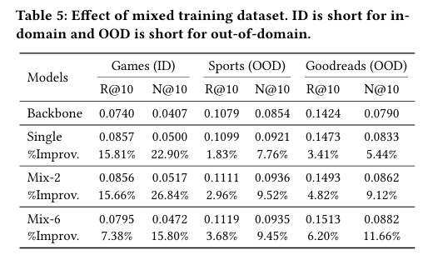
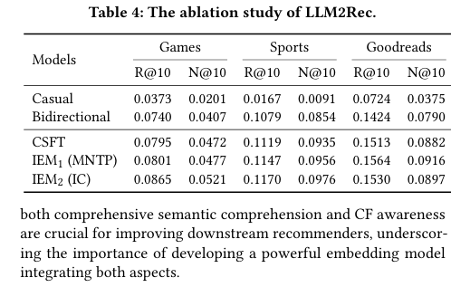
ATAI
Advanced Technique of
Artificial Intelligence
ATAI
ChongqingUniversity _{AdvancedTechniqueof}
of Technology Artificial Intelligence
Chongqing University of Technology
Experiments

Slide 14
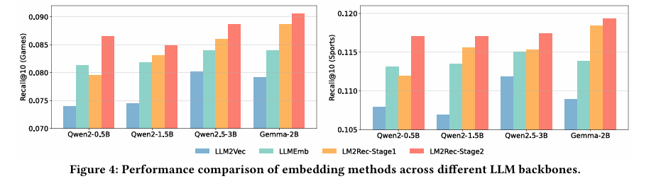
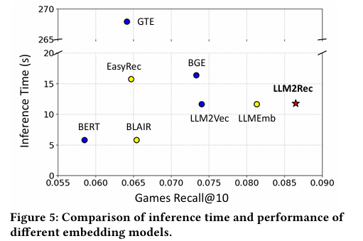
ATAI
Advanced Technique of
Artificial Intelligence
ATAI
ChongqingUniversity _{AdvancedTechniqueof}
of Technology Artificial Intelligence
Chongqing University of Technology
Experiments

Slide 15


ATAI
Advanced Technique of
Artificial Intelligence
ATAI
ChongqingUniversity _{AdvancedTechniqueof}
of Technology Artificial Intelligence
Chongqing University of Technology
Thanks!

